Slide 1


Eionet Thematic Group on Digital Capabilities and AI
In-Person meeting in Copenhagen
September 29-30, 2026
Summary

Slide 2
Topics
T1: Strategy, Governance and Organisation
T2: People, Skills and Ways of Working
T3: Data, Technologies and Infrastructure
T4: AI Applications and Value Creation
Targets
Outcomes
Actions

Slide 3
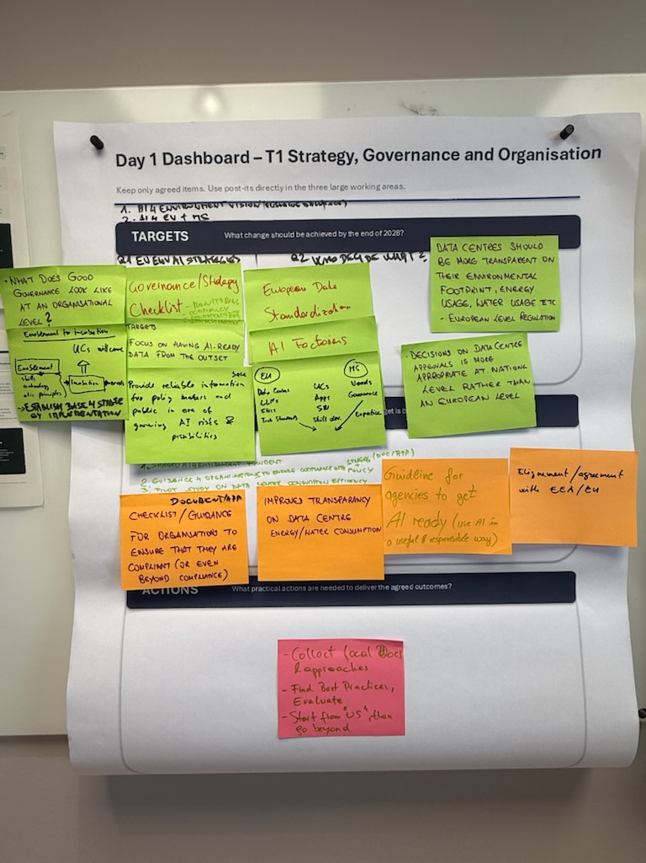
T1: Strategy, Governance and Organisation
TARGETS
AI for the environment: EU strategies by Q1 2027. Q2: who decides what?
Define organisational AI governance and a checklist for monitoring, compliance, EEA alignment and best practice.
Support needs-led incubation with skills, technology and ethics. Build AI-ready data from the outset.
Provide reliable information for policymakers and the public amid AI risks and opportunities.
EU AND MEMBER STATE ROLES
EU: European data, standardisation, AI factories, data centres, LLMs, ethics and technical standards.
Member States: needs, governance and expertise to inform use cases, apps, possible software and skills development.
Propose EU rules for transparent data-centre environmental, energy and water footprints. Keep approvals at national level.

Slide 4
T1: Strategy, Governance and Organisation
OUTCOMES
Shared AI for Environment empowerment
Guidance for organisations to ensure compliance with Strategy + policy (POC/ATP).
Pilot study on data center consumption efficiency
Documentation, checklists and guidance for For orgnisations to ensure that they are compliant (or even beyond-compliance).
Improved transparency of data-centre energy and water consumption.
Guidelines supporting agencies in becoming AI-ready and using AI in a useful and responsible way.
Alignment/Agreement with EEA/EU.

Slide 5
T1: Strategy, Governance and Organisation
ACTIONS
Collect local Docs and approaches.
Identify and evaluate best practices.
Start with internal experience and then broaden the exercise beyond.

Slide 6
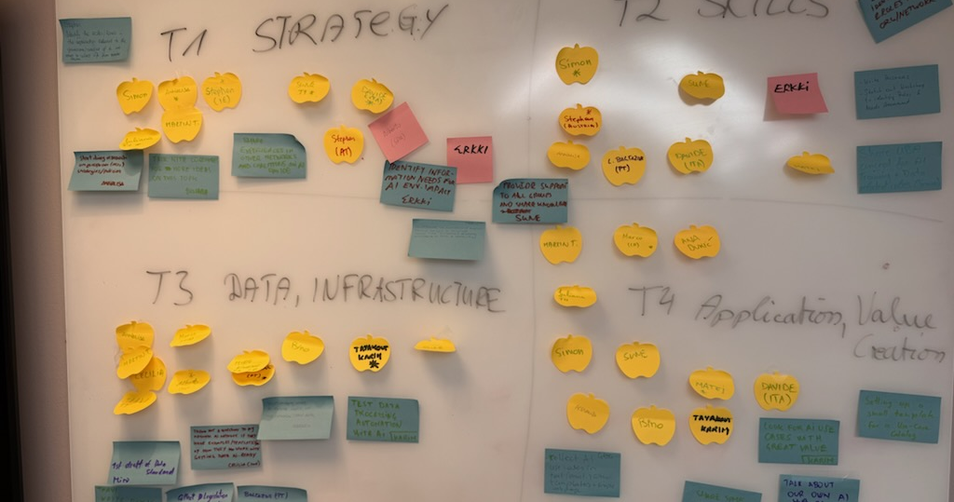
Group: T1 Strategy, Governance and Organisation
Annalisa Start doing research on European (MS) strategies/policies
Martin T. Contribute to summary of event. Propose input to roadmap. Initiate the outcomes template. Contribute to topics coordination
Juliana Talk with colleagues for more ideas on this topic
Stephen (IE) Identify the toles/levels in the organisation relevant to the governance/oversight of AI and stat to collect info from Member States
Sune Provide support to Group and share knowledge
Stephan
Davide Share experiences in other networks and coalitions on AI
Alberto
Erkki Identify information needs for AI Env. Impact
Simon

Slide 7
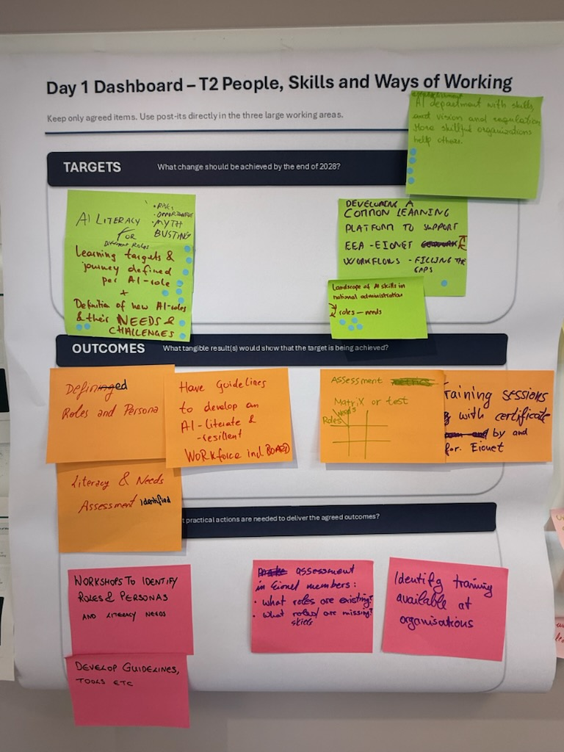
T2: People, Skills and Ways of Working
TARGETS
Establish AI literacy for different roles.
Risks, Opportunities, Myth Busting
Learning targets and journey defined per AI role +
Definition of new AI roles, including their needs and challenges.
Develop a common learning platform supporting EEA-Eionet workflows and filling identified gaps.
Map the landscape of AI skills, roles and needs in national administrations.
Establishment of AI department with skills, vision and regulation. More skillfull organisations support others

Slide 8
T2: People, Skills and Ways of Working
OUTCOMES
Defined roles and personas.
Literacy and need assessment identified
Have guidelines to develop and AI literate and resilient work force including board
An assessment matrix or test linking roles and needs.
Training sessions with certification by and for Eionet.

Slide 9
T2: People, Skills and Ways of Working
ACTIONS
Conduct workshops to identify roles, personas and literacy needs.
Develop supporting guidelines and tools etc.
Assess existing and missing roles and skills across Eionet members.
Identify training already available within organisations.

Slide 10
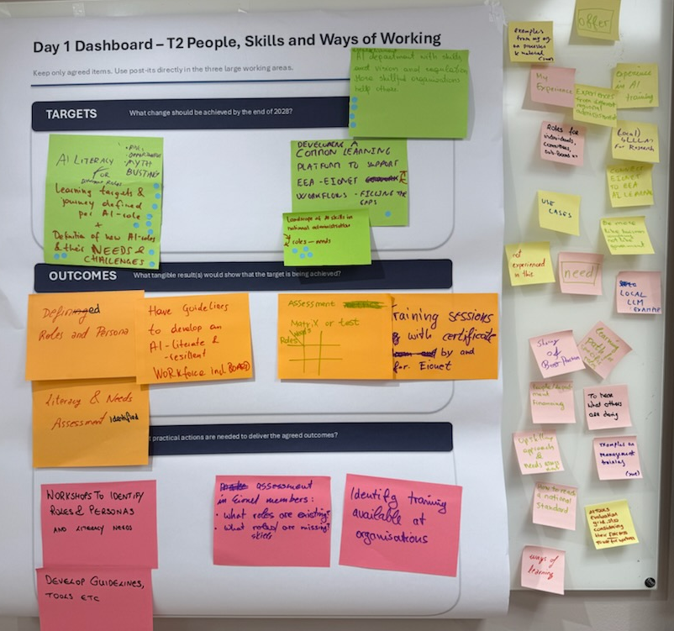
T2: People, Skills and Ways of Working
OFFERS
Examples from my organsation on processes and matriels
My experience
Experiences from different regional administrations
Experience in AI training
Roles fro individuals, comittees, sub boards (KT)
Local LLM for research
Connect Eionet to EEA AI learning
Use Cases
Be more like Business company not like government
Not experienced in this
NEED
Local LLM Example
Sharing of best practices
Learning path for specific roles
To hear what others are doing
People/Department financing
Upskilling approach and needs assessment
Examples on Management Training
How to reach a national standard
AI tools evaluation grid, also considering their fairness to use for workers
Ways of learning

Slide 11
Group: T2 People, Skills and Ways of Working
Simon Share UBA concept for AI. Training + Data related roles
Annalisa
Sune Provide support to Group and share knowledge
Stephan
Davide Share experiences in other networks and coalitions on AI
Alberto
Matej Identify information needs for AI Env. Impact
Erkki Idnetifying needs and roles in my opganisation/network
- Write personas
Sketch out workshop to identify roles and needs

Slide 12
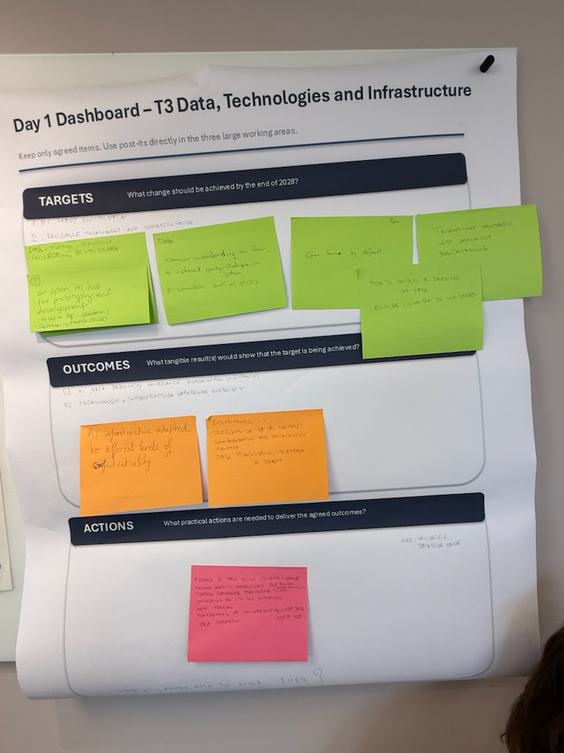
T3: Data, Technologies and Infrastructure
TARGETS
AI ready Environment data
Reusable technology and infrastructure
Data + Platfom + Technology
Collecting as is + to be data
Establish an open AI hub for prototyping and development. HW + API – Platform, Common infrastructures
Establish a common understanding of how to implement strategies and policies for data requirements for AI. AI connections such as MCPs
Open source by default (Tech)
Technology validation cost efficiency benchmarking.
How to improve AI readiness of data, ensure linkage to use cases

Slide 13
T3: Data, Technologies and Infrastructure
OUTCOMES
AI data readiness governance framework (+guidance)
Technology and Infrastructure reference overview
AI infrastructure adapted to different levels of confidentiality.
Benchmark - > Referance of AI platform recommendation for architecture standard
Data prioritisation roadmap and AI Ready

Slide 14
T3: Data, Technologies and Infrastructure
ACTIONS
Prepare AI data Reuse criteria + sample.
Develop agentic capabilities – MCP protocol
Prepare reference architecture pilots
Collect as is – to be situation
Best Practise
Propagation of Souvreignity (ensure data access)

Slide 15
Group: T3 Data, Technologies and Infrastructure
Martin T. Share UBA concept for AI. Training + Data related roles
Annalisa Start studying what IA-readiness implies for key institutions (ISPRA) data
Sune Provide support to Group and share knowledge
Cecilia Throw out a question to my national AI network if they have examples/templates of how they work with getting data AI-Ready
Taavi Write down Estonian requirements
Marco
Alberto Collect legislation about AI with affect to data
Miro First draft of data standard
L. Baltazar Gathering European data models
Bino
Tayakout Karim Test data processing automation with AI

Slide 16
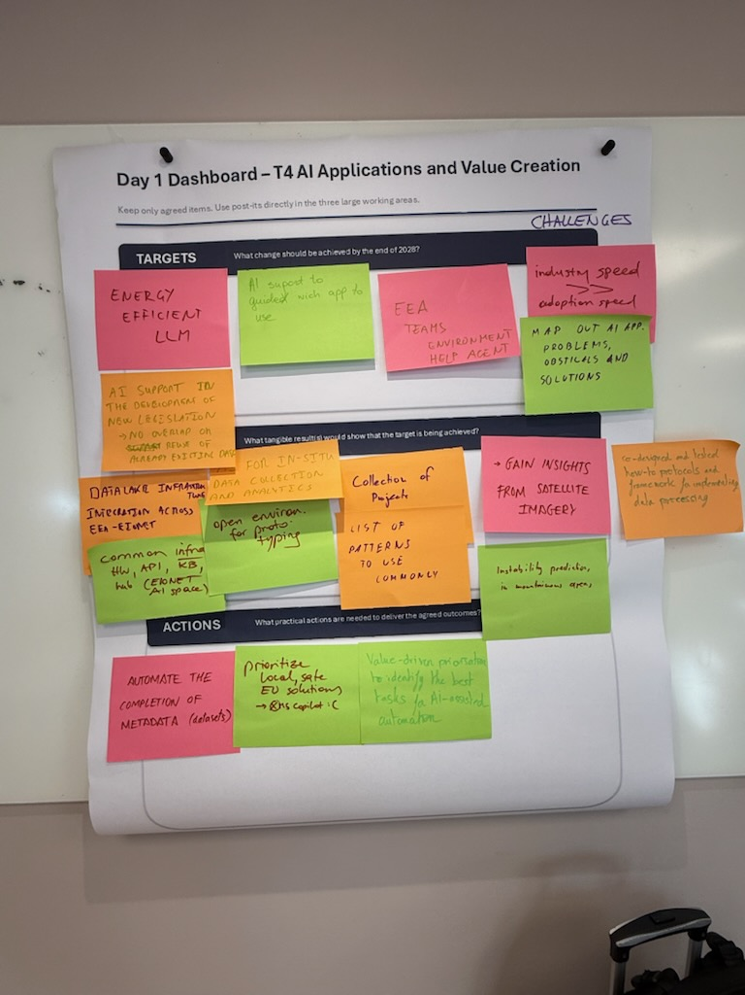
T4: AI Applications and Value Creation
TARGETS
Energy-efficient LLMs.
AI support to guide which app to use.
EEA teams environment help agent
Industry speed >> adoption speed
Map out AI app. Problems, obstacles and solutions
AI Support in the development of new legislation -> no overlap or reuse of already existing data

Slide 17
T4: AI Applications and Value Creation
OUTCOMES
Data Lake infrastructure integration across EEA-Eionet.
Common infrastructure HW, API, KB, Hub (Eionet AI Space)
AI for In-Situ data collections and analytics.
An open environment for prototyping
Collection of projects
List of patterns patterns to use commonly.
Insights derived from satellite imagery.
Instability prediction on mountainous area
Co-designed/tested how-to protocols and frameworks for data processing.

Slide 18
T4: AI Applications and Value Creation
ACTIONS
Automate completion of dataset metadata.
Prioritise local, safe EU solutions. (not MS Co-pilot)
Use value-driven prioritisation to identify the most suitable tasks for AI assistance or automation.

Slide 19
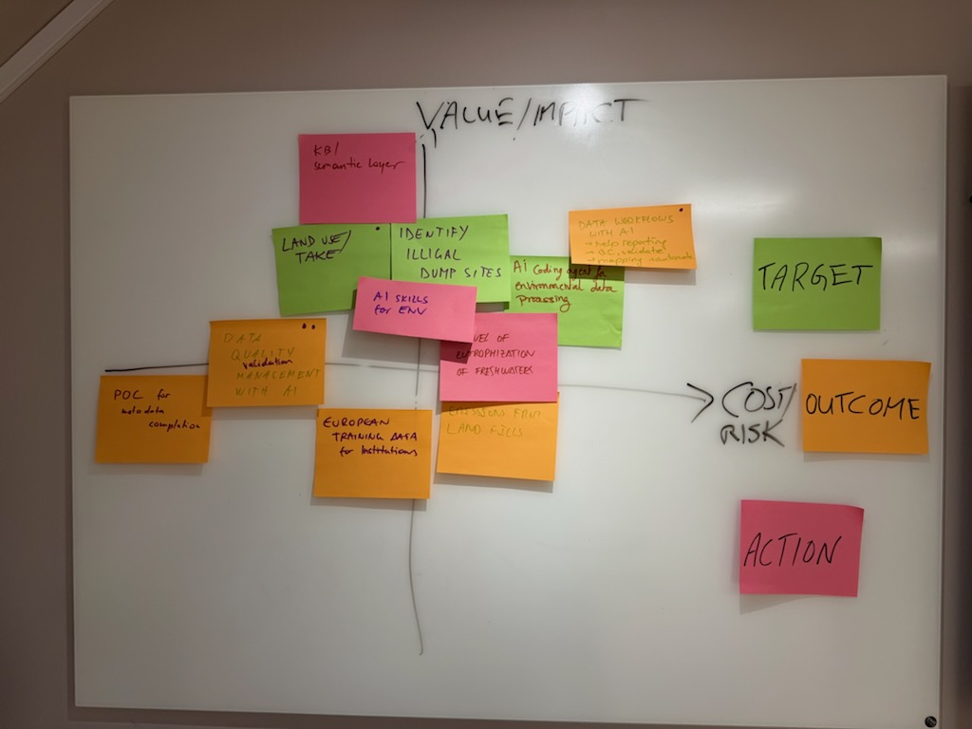
T4: AI Applications and Value Creation

Slide 20
T4: AI Applications and Value Creation
VALUE / IMPACT
TARGET
KB / Sematic Layer
OUTCOME
Datawork flows with AI
-Help reporting
-QC validation
-Mapping automate
ACTION
Land Use / Land Take
Identify illegal dumpsites
AI coding agent for env. Data processing
AI skills for Env.
Level of Eutrophication of freshwater.
Data Quality (validation) management with AI
POC for metadata completion
COST / RISK
European training data for Institutions
Emissions from landfills

Slide 21
Group: T4 AI Applications and Value Creation
Gregor Collect AI Use cases in text (struct.) Github templates + sample webpage
Martin T. Share UBA concept for AI. Training + Data related roles
Ana Talk about our own AI hub in our Ministry
Annalisa Start studying what IA-readiness implies for key institutions (ISPRA) data
Sune Provide support to Group and share knowledge
Juliana
Simon Share ”purpose first” approach
Bino Further explore the MCP integration for hydrological db. and Api and report findings and lessons learned back to the group
Marco
Tayakout Karim Look for a use case with great value
Davide Share some use cases
Matej List of use cases from environment agency
Setting up a small template for a se case catalog

Slide 23
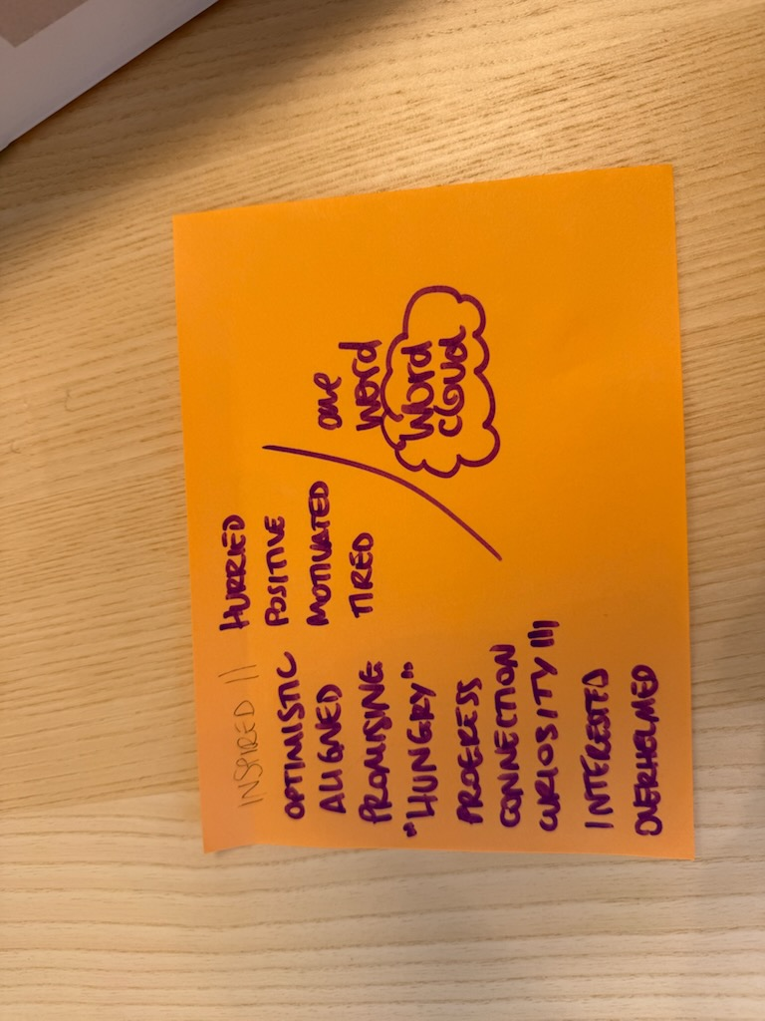
Overwhelmed
Inspired
Optimistic
Positive
Curiosity
Tired
Hungry
Connection
Aligned
Progress
Interested
Productive
Motivated

